Slide 1
Southern Region AWFISHNET
Mme Mashebane Thosago
President: South Africa chapter
Contact details: +27630529295
Oceans20 South Africa Inception Meeting for Stakeholders
Mpumalanga, South Africa
28 May 2025

Slide 2
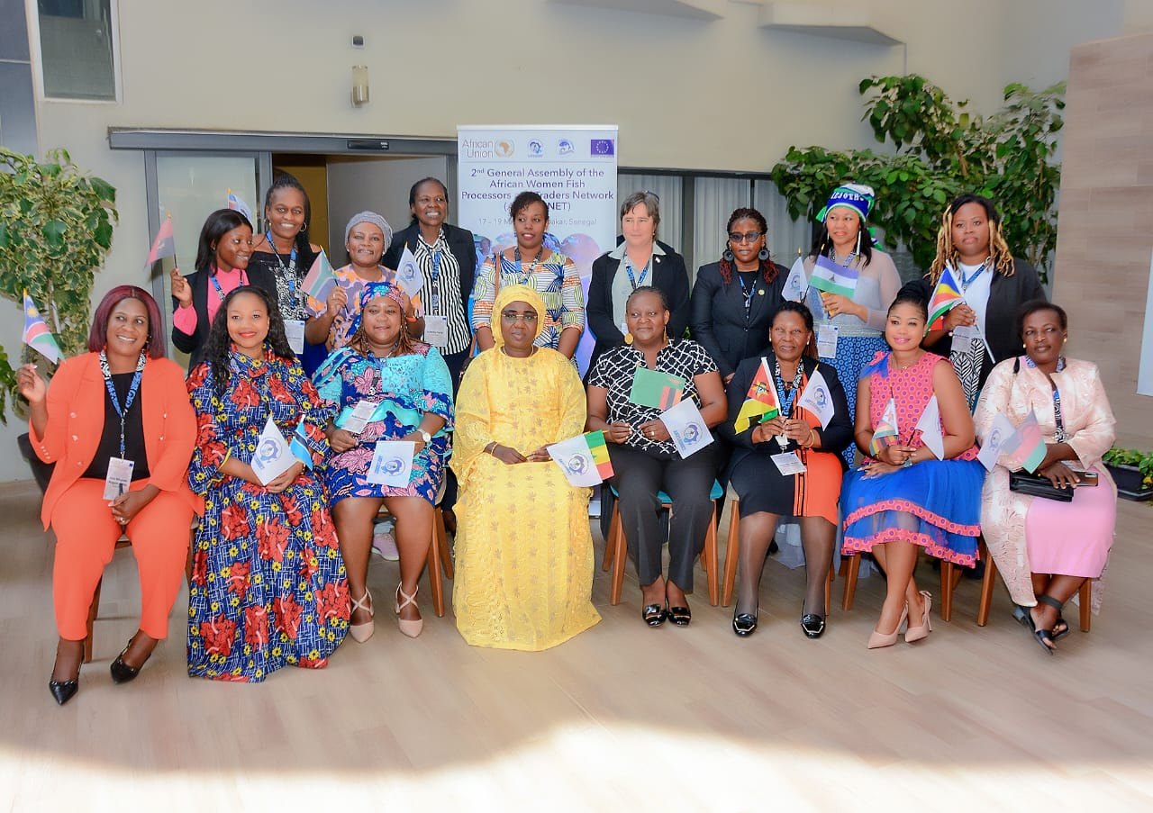
About Southern Region
There are 10 countries affiliated
South Africa
Zambia
Zimbabwe
Mozambique
Eswatini
Angola
Namibia
Malawi
Lesotho
Botswana
Four have launched country chapters and the rest have organized groups; Two to launch
Five have both inland and coastal SSF and aquaculture activities
Female and youth do participate in both sectors

Slide 3
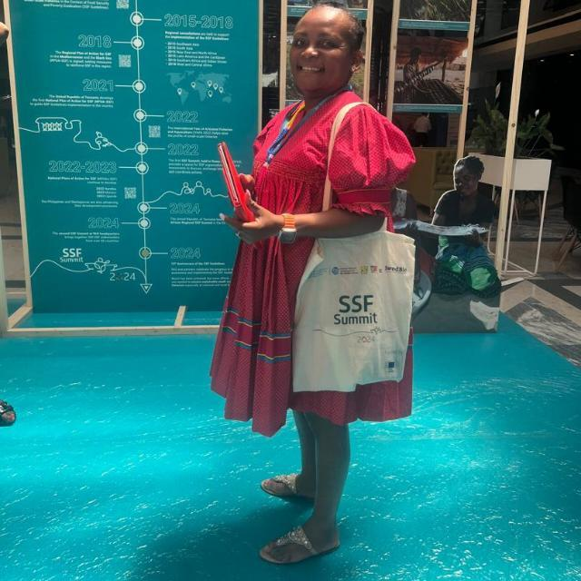
About Southern Region SSF
Main activities; - beach cast seaweed collections
- concession Right holders (marine species e.g crayfish, seaweed harvesting
- small scale aquaculture
- dam and river subsistence fishing
- Community outreach; online
- Information sharing; AU-IBAR ecosystem
- Capacity building
- Resources mobilization
Participation; - Legislation development, committee members
- Research groups
- Government-led fisheries and aquaculture gathering
- Women, fisheries and Aquaculture celebration events
- Formalization of networks and collaborations; MOU’s in place
- SMEs and Co-ops incorporations and meeting as observers
- Participation in projects implemented by government and knowledge institutions, e.g Fish4She
- Trainings; physical and online

Slide 4
Challenges
Fragmented and/ or non-inclusive legislation
Little recognition and support for women participants
Lack of strategies to transform for women and youth participation
Little support for registrations
No operational funding; few members carry the burden with their personal funds
Lack of funding to help women
construct more ponds
attend physical trainings and exchange programs (especially for project implementation)

Slide 5
Reaching more key stakeholders to advocate for social injustices
Inadequate infrastructure around water bodies and landing sites
Lack of direct access to markets
Infrastructure constraints identified but not limited to
access to products storage facilities
Processing equipment
Logistical transportation of products to local markets
Climate change constraints identified but not limited to
Scientific information to assist with planning and implementation
Drought and floods contingency plans or responses
Climate smart approaches and tools

Slide 6
Challenges
More specific gender Inequality and Discrimination
Women are often excluded from the process of deep-sea fishing due to perceived vulnerabilities in handling the inherent risks of offshore fishing.
are instead relegated to gathering fish near the shore or focusing on processing and trading.
Market buyers tend to undervalue the work of women, perceiving them as less capable of capturing high-value commercial fish compared to men.
Lack the necessary resources, such as appropriate fishing nets and small boats (like canoes).
Limited Access to Resources and Financial Support
During government-mandated fishing bans, women struggle to find alternative means of survival.
They frequently face challenges in accessing credit, technology, and adequate fishing equipment due to the absence of material guarantees, such as land or boat ownership, restricting their ability to grow or improve their businesses.
Encounter difficulties in negotiating fair prices for their products, as buyers tend to dominate price-setting decisions.

Slide 7
Challenges cont…
Namibia specific but applicable to most rural Southern areas
Not Enough Water
Many inland areas don't get much rain, so there's not enough water in rivers and lakes. This means fewer fish.
Fish Going to Waste: When they catch fish, it often spoils because there's no electricity for fridges. So, a lot of the fish gets thrown away.

Slide 8
Achievements and
Opportunities
New legislation being developed
Recognition and support of AWFISHNET by AU; country adaptation
Country chapters in progress to be registered
Training initiatives increasing; with focus on women and youth participation
Focused leadership programmes
Collaborations regionally and internationally
Dam stocking e.g in 2024, Zimbabwe stocked over 300tonnes fingerlings were stocked in various dams
Women contribution to the workforce through programs like Fish4she and drives to remove them from toxic environments

Slide 9
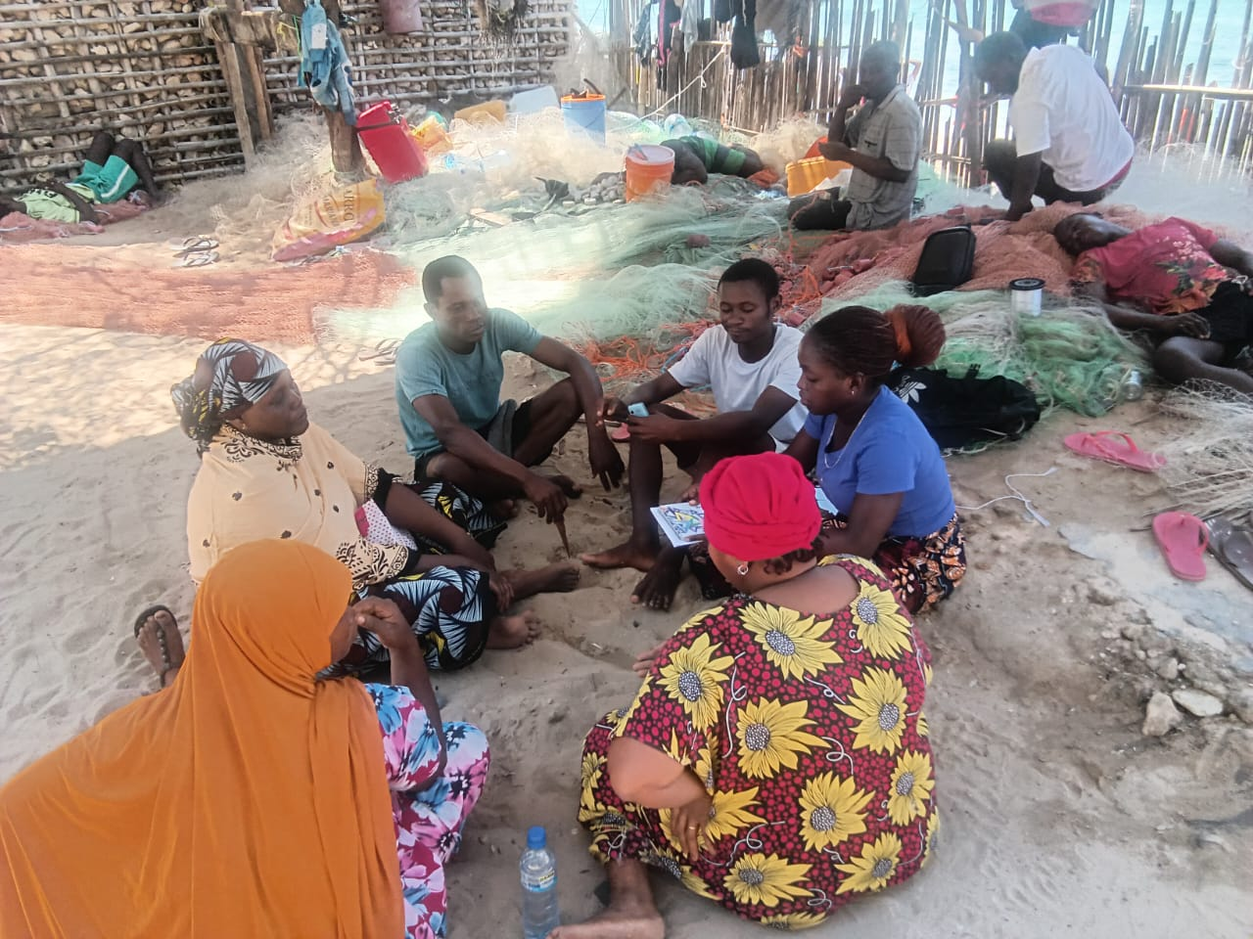
Achievements and Opportunities
Registering small-scale fishers, a new approach being used by ADPP to transfer capacity: An established fisher, works with smaller-scale fishers to facilitate access to resources and improve quantity due to unity in numbers. Ruela, Cabo Delgado province.

Slide 10
Achievements and Opportunities
AWFISHNET Malawi chapter has partnered with CDF Canada in the IAAM Project (Integrated Aquaculture - Agriculture to combat food insecurity in Malawi)
In this project AWFISHNET will implement a number of activities including:
Building capacity of co-operatives and SMEs for value addition in fish value chains, including product quality, food safety, packaging etc.
Implement branding and marketing strategy and food safety protocols for value-added fish products for commercialization
Develop best practices on food nutrition and the production of fish-crop based nutrition products for household consumption
AWFISHNET Malawi is partnering with GIZ as beneficiaries in the Sustainable Aquatic Foods (SAF PROJECT)
Activities in this project will include:
Capacity building of the Executive Members
Exchange programs
Business management skills/Business plan
Proposal designing and writing

Slide 11
Registrations and memberships
As of September 2024, AWFISHNETO registered. However, we are still awaiting the formal certificate of registration.
Successfully recruited 26 members
Green light to officially launch the Botswana Chapter of AWFISHNET. We are now only awaiting a confirmed launch date from AU-IBAR to proceed with the event
Partnered with Iowa University USA by engaging one of their students, who is currently interning with AWFISHNETO
SANWFA has 200 members
NAMFISHNET to date has 100 members

Slide 12
Areas of needed support
Advocacy to governments for Country Chapters to be included in projects where local women are being supported
Inclusion of more women in organizational gatherings to capacitate more
Linkages with robust organisations that have market access platforms
Information sharing on fellow country projects to avoid duplication and resource wastages
Assistance in establishing common use storage facilities
Assistance with establishment of Processing equipment (Common project in countries of need)
Linkanges and facilitation of affordable logistical transportation services
Support for policy implementation and monitoring advocacy
Assistance in developing climate – resilient strategies
Assistance in accessing climate change scientific information, trainings, workshops and support

Slide 13
Areas of needed support
General Trainings
Advocacy, outreach programmes and recruitment
Business skills
Facilitator/ Moderator/ Assesor
Marketing
Negotiation
Train the trainer

