Slide 1
Inception Meeting - 28 May 2025
Ocean Actions

Slide 2
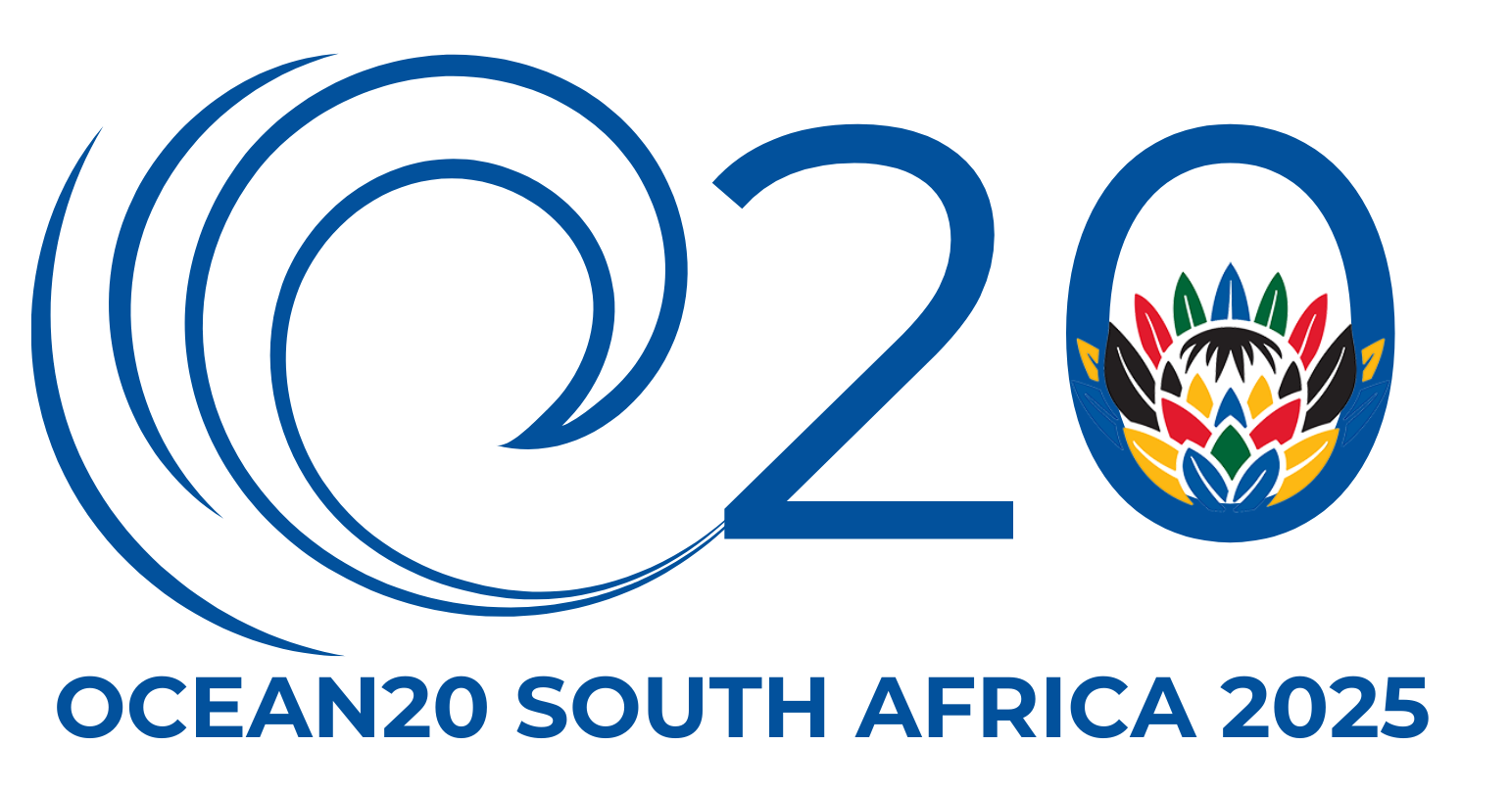
Higher level initiatives
Singapore Maritime Week 2025 (24-28 Feb 2025)
Two sessions:
Maritime Just Transition
Maritime Security
Attended and well received by Her Excellency Charlotte Lobe, High Commissioner for South Africa in Singapore

Slide 3
New Ocean Actions to foster - Blue Foods
Small-scale fisheries and aquaculture
Inland communities
Interest from:
MK Enterprise (Pty) Ltd
AUDA-NEPAD
Better Food Future's Data to Dish; in support of UN Global Compact Ocean Stewardship Coalition Tipping Point 1, Fully Traceable Sustainable Seafood Supply Chains
Interest through:
Wholechain and UNGC
From Rivers to Oceans: Connecting Inland Communities to the Blue Economy
Interest through:
Ocean20 Outreach event, Mbombela
With more to discuss later on!

Slide 4
New Ocean Actions to foster - Coastal Resilience
Transdisciplinary approach to biodiversity enhancement on urban coasts—rooted in Indigenous knowledge co-creation and nature-based solutions
Interest from:
NRF-SAIAB
Establish a national Coastal Pollutant Bioindicator Network that utilises shellfish species to track heavy metals, microplastics, and other emerging contaminants in South African coastal waters and develop standard regulatory limit for safe seafood consumption
Interest through:
NRF-SAIAB

Slide 5
New Ocean Actions to foster - Accessible Ocean
Technology & Capacity
Local development of maritime autonomous technology
Interest from:
Private industry
(Universities, SOCCO, etc)
Collaboration with the GloNoise Project Partnership to combat underwater radiated noise (URN)
Interest through:
Damen Shipyards
With many initiatives already underway as presented earlier!
Notes:
Added “Capacity” here because I do think it is an important aspect that we also need to develop the capacity to manage, implement, maintain etc the new technology…. Capacity can basically be embedded in every single action

Slide 6
New Ocean Actions to foster - Deep-sea research
Unlocking the Deep – Advancing Knowledge, Innovation and Governance for Deep Ocean ecosystems
Interest from:
NRF-SAEON
NRF-SAIAB
SANBI
This would link to many already established global networks and communities focused on deep-sea research!

Slide 7
New Ocean Actions to foster - Ocean modelling
SOMISANA - building a skilled, multi-faceted ocean modelling cohort for Southern Africa
Interest from:
NRF-SAEON
Linking to several global and regional ocean modelling efforts!

Slide 8
New Ocean Actions to foster - Agulhas Current
Designing and implementing a ocean observation monitoring system for the Agulhas Current
Interest from:
NRF-SAEON
The Ocean Action would connect to many of the categories listed above, including coastal resilience, marine technology, deep-sea research and ocean modelling!

