Slide 1
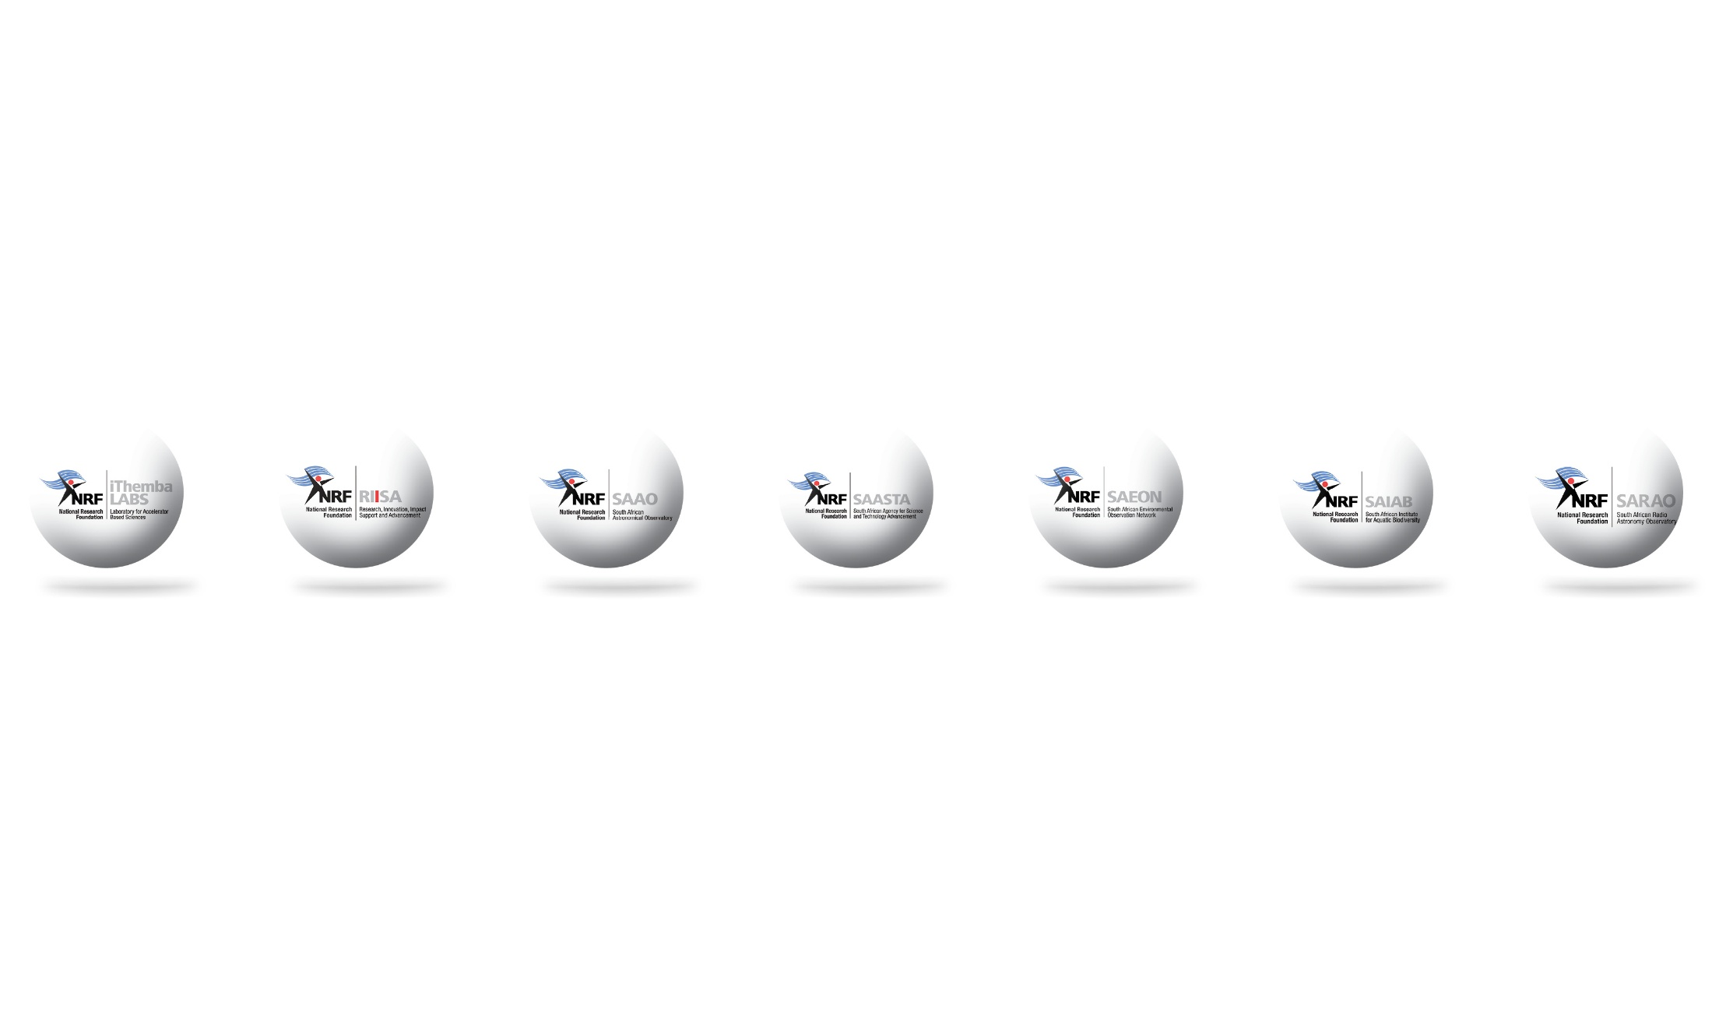
Re-imagining the South African Marine Research and Exploration Forum (SAMREF)
Nicole du Plessis
NRF-SAEON
28 May 2025

Slide 2
SAMREF
Established in 2016 under the Operation Phakisa Ocean Economy Oil and Gas Lab
Goals of SAMREF:
Identify and take advantage of opportunities provided by maritime industry (Oil & Gas, Fisheries, Tourism, Transport) to gather important marine ecosystem data which would otherwise be difficult and expensive to obtain.
Facilitate new collaborative offshore studies that would increase South Africa’s state of knowledge of the offshore marine environment, related to renewable energy potential, marine biodiversity and ecology, climate change and ecosystem functioning.

Slide 3
SAMREF 2.0
In enhancing the function of SAMREF we aim to:
Strengthen international cooperation in marine science, technology, and capacity enhancement
Promote shared expertise and technology transfer
Encourage information sharing on financial resources such as public-private-philanthropic partnerships (PPPPs)
Support advancing inclusive and adaptive ocean governance frameworks
Encourage creating platforms for financial collaboration and innovation-driven progress

Slide 4
Thank you!

