Slide 1
Inception Meeting - 28 May 2025
Ocean Economy Taxonomy

Slide 2
Interactive discussion
What do you understand by the term Ocean Economy?

Slide 3
Interactive discussion
What do you understand by the term Blue Economy?

Slide 4
Blue Economy - A Developing Term
“The decoupling of socio-economic activities and development from environmental degradation and optimizing the benefits which may be derived from marine resources”, Alam et al., 2020
“A ‘sustainable’ ocean (or “blue”) economy emerges when economic activity is in balance with the long-term capacity of ocean ecosystems to support this activity and remain resilient and healthy”, Findlay, 2023
“[A] practical ocean-based economic model using green infrastructure and technologies, innovative financing mechanisms and proactive institutional arrangements for meeting the twin goals of protecting our oceans and coasts and enhancing its potential contribution to sustainable development, including improving human well-being, and reducing environmental risks and ecological scarcities”, Gonzales et al., 2019
“‘Blue Economy’ includes all the uses depending on the sea (located either on land or sea) and producing an economic output”, Niavis, 2017
“[E]conomic and trade activities that integrate the conservation and sustainable use and management of biodiversity, including maritime ecosystems, and genetic resources”, van Wyk, 2015

Slide 5
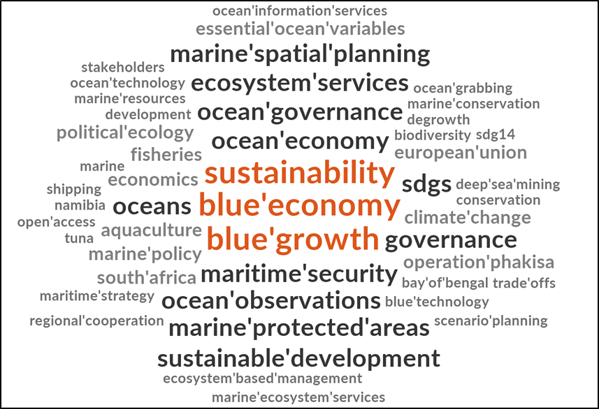

Slide 6
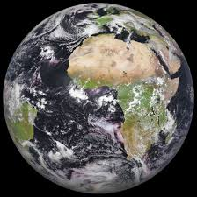
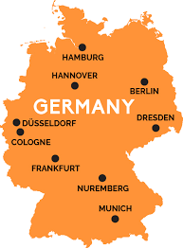
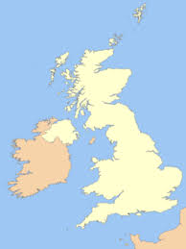
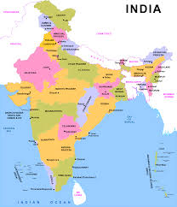
What is the Ocean Economy worth?
It is the 5th largest economy globally
If it were a country, it would outrank Germany, India and the UK

Slide 7
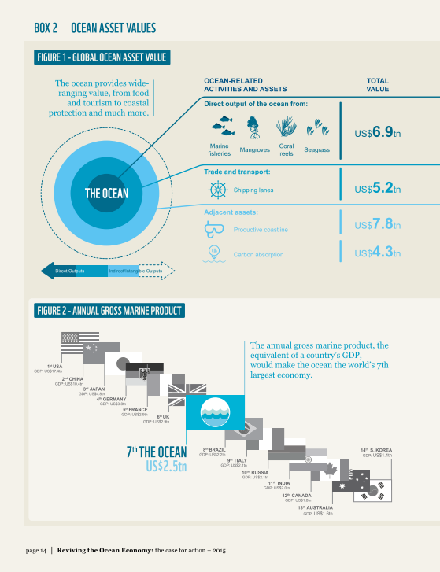
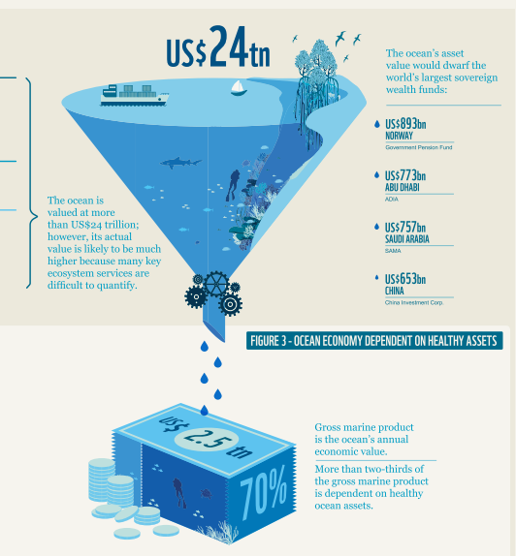
WWF, 2015

Slide 8
What is the Ocean Economy worth?
3 - 4 %
Global economic output
133 million
Supports full-time jobs

Slide 9
Interactive discussion
What is the potential for growth in South Africa?
Particularly for businesses, innovators and society?
Where are the gaps?

Slide 10
Interactive discussion
How do we connect with inland communities?

Slide 11
Interactive discussion
Where is the growth for curriculum development, both at high school and higher education?

Slide 12
Interactive discussion
Next steps:
Discussion paper from this interaction
Potential for an in-depth workshop - is there an appetite for this?

